Slide 1
Lesson 2 - Basics

Slide 2
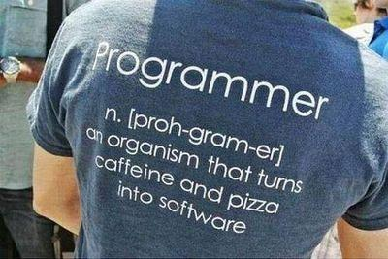
Lesson goals
What is Java
Variables
Datatypes
Operators
Structures
Built-In classes
Strings
Numbers
System
Scanner

Slide 3
Java Platform
1. Standart Edition
2. Enterprise Edition
3. Midlet Edition
1996
1997
1998
2000
2002
2004
2006
2011
2014
2017
2018
2019
2020
1.0
1.1
1.2
1.3
1.4
1.5
1.6
7
8
9
10
11
12
13
14
15
3

Slide 4
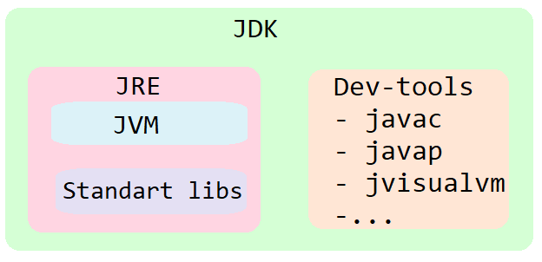
JVM vs JRE vs JDK

Slide 5

Java pros
👍 Cross-platform
👍 Secure
👍 Powerful
👍 Multithreaded
👍…
👍 Popular

Slide 6
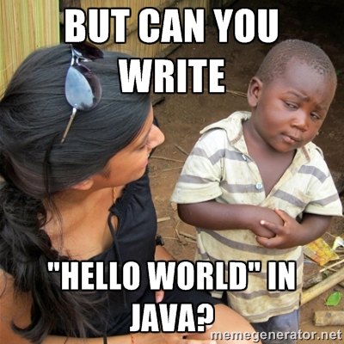

Slide 7





How it works?
javac.exe
java.exe
JVM
HelloWorld.java
HelloWorld.class

Slide 8
Hello World
public class HelloWorld { public static void main(String[] args) { System.out.println("Hello World!!!"); } }
c:\> javac HelloWorld.java
c:\> java HelloWorld Arg1 Arg2 777

Slide 9
Program
int a = 1;
int b = 1;
int c = 6; int D = b * b - 4 * a * c; /* discriminant */ if (D >= 0) { int x1 = (-b + Math.sqrt (D)) / (2 * a); int x2 = (-b - Math.sqrt (D)) / (2 * a); }
Code
+
Whitespaces
+
Comments
The same to
int a=1,b=1,c=6;int D=b*b-4*a*c;if(D>=0) {int x1=(-b+Math.sqrt(D))/(2*a);int x2=(-b-Math.sqrt(D))/(2*a);}

Slide 10
Java Syntax
Static typed
Case sensitive
Statements separated by semicolon ;
Wrap blocks in braces {}
Spaces (4) vs tabulation
Comments
// one line
/* multiline */
/**Java doc */

Slide 11
Variables
type
value
int size = 41;
name

Slide 12
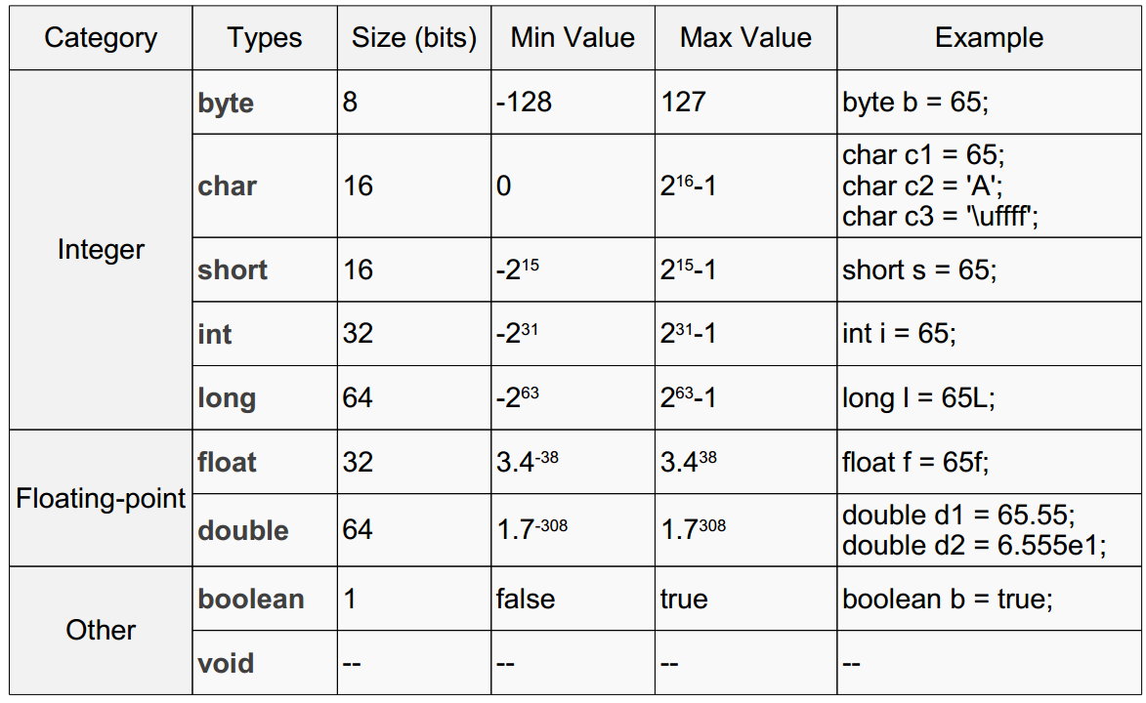
Primitive types

Slide 13
Keywords
Primitive types and void | Modifiers | Declarations | Control Flow | Misc
boolean | public | class | if, else | this, super
byte | protected | interface |  | new
char | private | enum | try, catch, finally | _ (underscore)
short | abstract | extends | do, while | import
int | static | implements | continue, break, return | instanceof
long | final | package | throw | null
float | transient | throws | default | true, false
double | volatile |  | for | assert
void | synchronized |  | case | strictfp
 | native |  | switch | goto
 |  |  |  | const

Slide 14
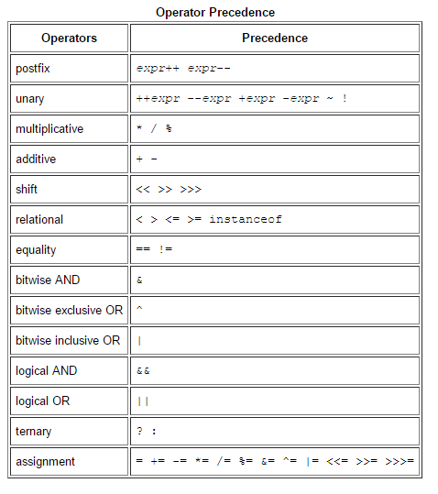
Operators

Slide 15
What will be printed?
class HelloWorld { public static void main(String args[]) { int a = 5; int b = a; a = 3; System.out.println(b); } }

Slide 16
Conditional operator if else
int n = readNumber(); if (n == 1) { System.out.println("1"); } else if (n == 2 || n == 3) { System.out.println("2 or 3"); } else { System.out.println("4"); }

Slide 17
Conditional operator switch
int n = readNumber(); switch (n) { case 1: System.out.println("1"); break; case 2: case 3: System.out.println("2 or 3"); break; default 4: System.out.println("4"); }

Slide 18
Loop while “do”
while (condition) { statement; }
int count = 0; while (count < 5) { System.out.println(count); count++; }

Slide 19
Loop “do” while
do { statement; } while (condition);
int count = 0; do { System.out.println(count); count++; } while (count < 5);

Slide 20
Conditional loop for
for (initialization; condition; increment){
statement;
}
for (int count = 0; count < 5; count++) { System.out.println(count); }

Slide 21
Branching statement break
int maxRetries = 10; for(int i = 0;;) { if(i > maxRetries){ break; // stop iteration and exit from the loop
} doSomething();
i++; }

Slide 22
Branching statement continue
for(int i = 0;; i++) { if(i % 5 == 0){
doSomethingAnother();
continue; // skip current iteration
} doSomething(); }

Slide 23
Branching statement return
for(int i = 0; i < 10; i++) { if(i > 5) { return -1; // stop iteration and exit from method } doSomething(); }
return result;

Slide 24
java.lang.Object
In Java, "almost" all data are objects and inherit Object
boolean equals(Object);
int hashCode();
String toString();
…

Slide 25
java.lang.Object
class Point { private int x; private int y; public Point(int x, int y) { this.x = x; this.y = y; } // getters and setters void draw(){ // ... } }

Slide 26
What will be printed?
Point p1 = new Point(3, 5); Point p2 = p1; p1.setX(7); println(p2.getX()); Point p3 = new Point(3, 5); Point p4 = p3; p3 = new Point(7, 9); println(p4.getX());

Slide 27
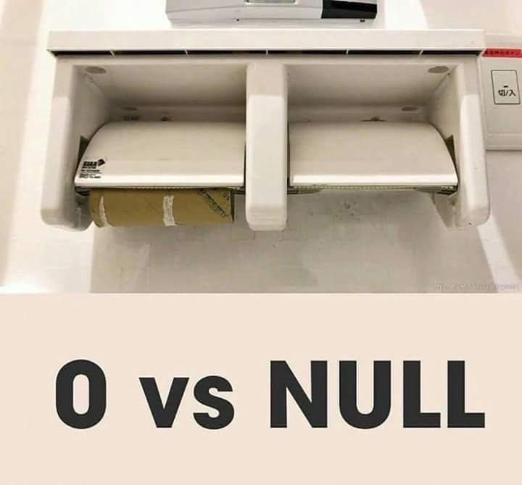
Null is not a Zero
Only objects can be null
Primitive types – cannot
String nullText = null;
String emptyText = “”;

Slide 28
Arrays
int array[] = new int[5]; //[0, 0, 0, 0, 0] for (int i = 0; i < 5; i++) { // indexing starts from 0 array[i] = i * i; // [0, 1, 4, 9, 16] }
Object array[] = new Object[3]; // [null, null, null] String matrix[][] = {{"aaa", "bbb", "cde"}, {"1", "2"}};

Slide 29
java.util.Arrays
public static void sort(int[] a);
public static int binarySearch(int[] a, int key);
public static boolean equals(int[] a, int[] a2);
public static boolean deepEquals(Object[] a1, Object[] a2);
public static void fill(int[] a, int val);
public static String toString(int[] a);

Slide 30
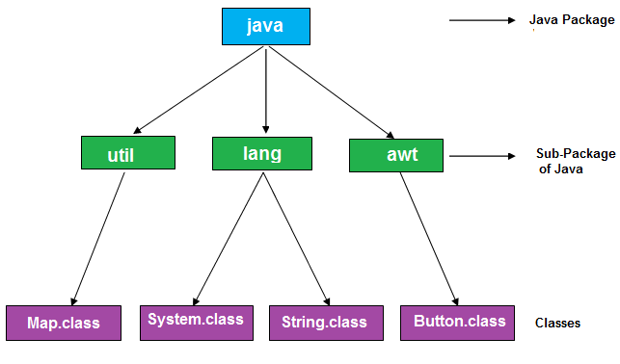
Packages

Slide 31
Imports
import <package.name>.<classname>;
Reverse domain name convention
java.lang is imported by default
Importing a Package Member
import java.util.Map; import java.util.HashMap;
….
Map map = new HashMap();
Importing an Entire Package
import java.util.*;
….
Map map = new HashMap();

Slide 32
java.lang.String
Data type String is used for storing sequence of Unicode characters.
String empty = "";
String emptyUsingConstructor = new String ();
String flash = new String ("Flash") ;
String batman = "Batman" ;
String concatMessage = "NaNaNaNaNa ".concat(batman);
String plusMessage = "NaNaNaNaNa " + batman;

Slide 33
Immutability of String
String character = “Sponge Bob”;
System.out.println(character.toLowerCase());
// sponge bob
System.out.println(character);
// Sponge Bob

Slide 34
Useful methods of String class
int length(); boolean isBlank(); boolean equals(Object anObject); int indexOf(int ch);
String repeat(int count); String substring(int beginIndex, int endIndex); String concat(String str); boolean contains(CharSequence s); String replace(char oldChar, char newChar); String strip(); String[] split(String regex);
…

Slide 35
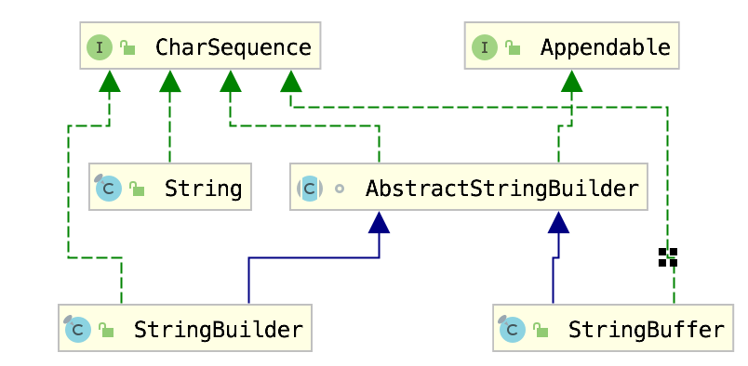
String vs StringBuilder vs StringBuffer

Slide 36
StringBuilder \ StringBuffer
StringBuilder append(Object obj); StringBuilder delete(int start, int end); StringBuilder replace(int start, int end, String str); StringBuilder insert(int index, char[] str, int offset); int indexOf(String str); int lastIndexOf(String str); StringBuilder reverse(); String concat(String str);
…

Slide 37
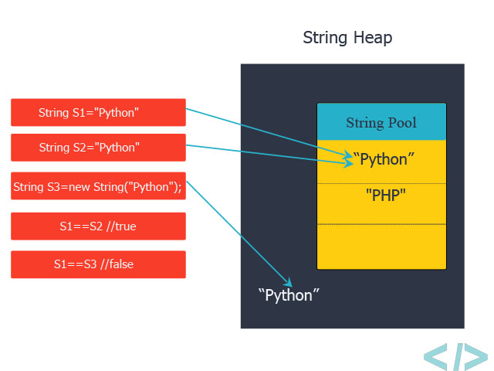
String Pool

Slide 38
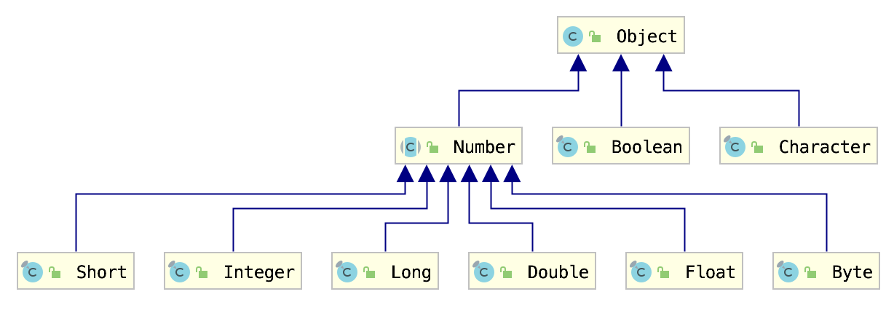
Wrapper Classes

Slide 39
Wrapper Classes
• Overloaded operations
• Pass by value
public static void sum(Integer i) { i = i + new Integer(2); } public static void main(String[] args) { Integer a = 10; sum(a); int b = 10; sum(b); System.out.println("a = " + a); System.out.println("b = " + b); }

Slide 40
Useful methods and fields
Wrapping methods:
Integer::valueOf(int)
Integer::valueOf(String)
Double::valueOf(double)
…
Constants like min/max values of primitive types:
Integer.MAX_VALUE
…
Conversion to another type:
Number::intValue
Number::floatValue
…

Slide 41
Autoboxing and Unboxing
Integer autoboxed = 47; // -> Integer.valueOf(47);
int unboxed = Integer.valueOf(47); // -> 47;

Slide 42
Performance Problem Example
long startTime = System.currentTimeMillis(); Long sum = 0L; for (Long i = 0L; i < Integer.MAX_VALUE; i++) { sum += i; } System.out.println("total:" + sum); long executionTime = System.currentTimeMillis() - startTime; System.out.println("processing time: " + executionTime + " ms");

Slide 43
java.lang.Math
public static double sin(double a)
public static double cos(double a)
public static double exp(double a)
public static double sqrt(double a)
public static double pow(double a, double b)
public static int round(float a)
public static int abs(int a)
public static int max(int a, int b)
public static int min(int a, int b)
…

Slide 44

java.lang.System
System.out.printf("Hello World!")
System.out.println("Hello World!")
System.currentTimeMillis()
System.exit(1)
System.getProperty("path.separator")
System.gc()

Slide 45
java.util.Scanner
Scanner scanner = new Scanner(System.in);
String string = scanner.next();
int count = scanner.nextInt(); scanner.close();

Slide 46
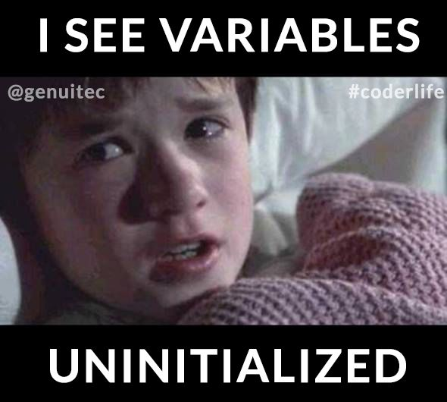
Garbage Collector

Slide 47
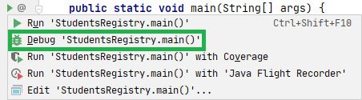
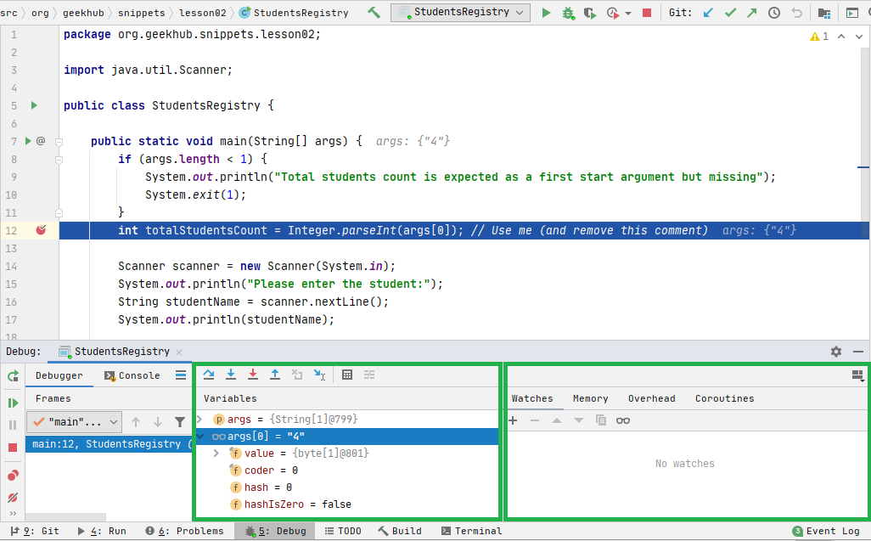
Debugging

Slide 48
Literature
Java Basics:
Getting started
Language Basics
Classes and Objects
Auto boxing and Unboxing
Strings
Arrays
Memory model
Books:
“Clean Code” by Robert Martin (chapter 1-2)
“Java: The Complete Reference” by Herbert Schildt (chapter 2-6)

Slide 49
Homework
Install IDE Feature Trainer plugin and complete practice for easier further development
Implement a simple Students Registry console application. App should accept students number (n) as a start argument (exit with error code when argument was not specified). In runtime ask user to input n non-empty strings via console (when user inputs empty string or input contains only whitespaces ask again). After all names entered, print all names sorted in alphabetical case-insensitive order.
Register on HackerRank skill and solve this challenge where we need count words in a one camel-case string

Slide 50
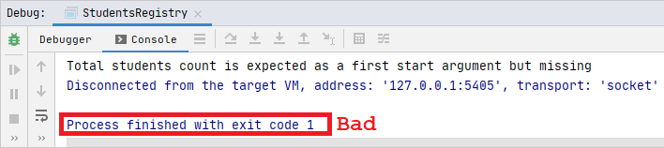
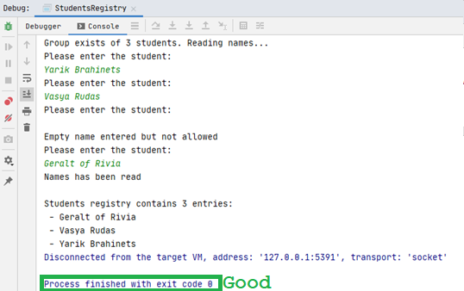
Homework example flow

Slide 51
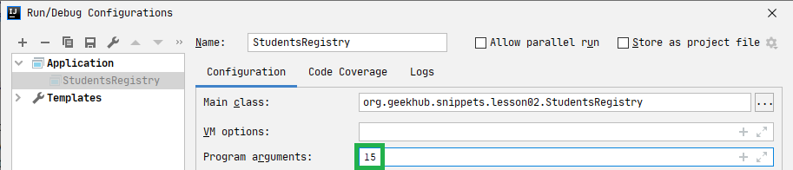
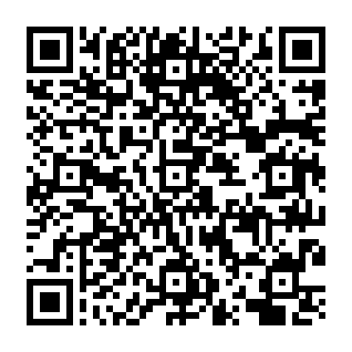
Homework hints
Homework snippet can be found here and by QR

Slide 52
Thanks!
Questions?
Find us in Slack:
@Yaroslav Brahinets
@Vasya Rudas

